Slide 1
Data Analysis in Python Pt. 1: Supervised Learning

Slide 2
Agenda for Today
Goals of machine learning models
Supervised vs. unsupervised learning
How supervised learning works
How to implement a supervised model using scikit-learn package in Python

Slide 3
Typical analysis pipeline
1
2
3
4
Data Generation
Data Manipulation
Model Fitting
Model Evaluation
Your own handy dandy scripts

Slide 4
Typical analysis pipeline
1
2
3
4
Data Generation
Data Manipulation
Model Fitting
Model Evaluation
Your own handy dandy scripts

Slide 5
Motivation for using a statistical vs. machine learning model
Statistical Models
Machine Learning Models
Model Inference
Assessing Parameter Robustness
Prediction-Focused Tasks
High-Dimensional Data
Notes:
- Give example on inference; maybe

Slide 6
Motivation for using a statistical vs. machine learning model
Statistical Models
Machine Learning Models
Model Inference
More often than not, the line between statistics and machine learning is blurry!
Assessing Parameter Robustness
Prediction-Focused Tasks
High-Dimensional Data
Notes:
- Give example on inference; maybe

Slide 7
Machine learning is often broken down into 2 types of learning
Supervised learning
Unsupervised learning

Slide 8
Supervised Learning
Input Data:
X: Data Matrix
Y: Label vector
Features
Label
Samples
Samples
Goal: Train a model to learn the relationship between X and Y

Slide 9
Unsupervised Learning
Input Data:
X: Data Matrix
Y: Label vector
Features
Label
Samples
Samples
Goal: Train a model to find hidden structure in X

Slide 10
Unsupervised vs. supervised example
Gene 2
Gene 2
Gene 1
Gene 1

Slide 11
Supervised Learning
Input Data:
X: Data Matrix
Y: Label vector
Features
Label
Samples
Samples
Goal: Train a model to learn the relationship between X and Y

Slide 12
Supervised models can be further described by whether their predictions are discrete or continuous
Notes:
https://towardsdatascience.com/machine-learning-an-introduction-23b84d51e6d0

Slide 13
Example supervised learning regression problem
Input Data
X: Cell gene transcript counts
Y: Cell motility scores
Genes
Scores
Cells
Cells

Slide 14
Example supervised learning regression problem
Input Data
X: Cell gene transcript counts
Y: Cell motility scores
Genes
Scores
Cells
Cells
Model to Learn:

Slide 15
Loss functions help us judge the quality of the model
Model predictions
Function to assess quality of model prediction on single input

Slide 16
In practice, minimizing model loss can lead to overfitting the data

Slide 17
New goal: learn a model that best performs on data with unobserved labels
Common practice is to break up your data into at least 2 sets:
A dataset used to train the model → training set
A dataset used to assess the model’s performance on unseen data → testing set

Slide 18
Typical supervised model evaluation scheme
Training Data
X_train
Y_train
Input Data
X
Y
1
Split the data into training and testing sets
Testing Data
X_test
Y_test

Slide 19
Typical supervised model evaluation scheme
Training Data
Define and Train Model
X_train
Y_train
2
Fit the model to the training data

Slide 20
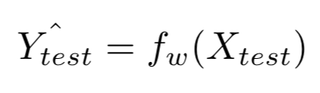
Typical supervised model evaluation scheme
Testing Data
Predictions of trained model on test set
X_test
Y_test
3
Obtain predictions of trained model on holdout test set data

Slide 21
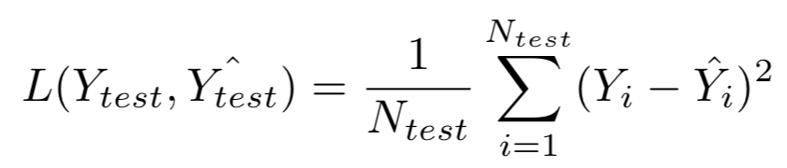
Typical supervised model evaluation scheme
Testing Data
Evaluate the test set predictions compared to the true values
X_test
Y_test
E.g. Mean Squared Error of Models’ Predictions on Test Set:
4
Evaluate predictions of model on the test set

Slide 22
Demo
https://scikit-learn.org/stable/user_guide.html
Notes:
10 mins up to here

Slide 23
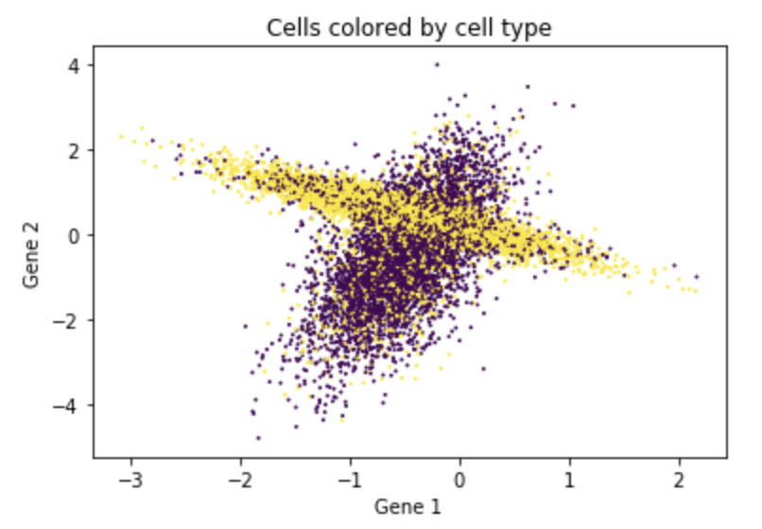
Homework: train a classification model to predict cell types from expression data
Input Data
X: Cell gene transcript counts
Y: Cell type labels
Genes
Cell Type (0 or 1)
Cells
Cells

Slide 24
K-Nearest Neighbors
K: number of nearest neighbors to base our class predictions off of

